Slide 1

React with Redux

Slide 2
Traditional Websites
BROWSER
SERVER
HTTP + URL
NAVIGATION
HTML PAGES
CSS
HTML + CSS
HTTP + URL
HTML + CSS
Page
Reload!

Slide 3
Traditional Web Apps
BROWSER
SERVER
HTTP + URL
NAVIGATION
HTML + CSS
Server PAGES
CSS
HTTP + URL
ASP
ASP .NET
JSP
PHP
Ruby
Express JS
Database
HTML + CSS
Page
Reload!

Slide 4
Traditional Web Apps – Partial Rendering
BROWSER
SERVER
HTTP + URL
NAVIGATION
Server PAGES
CSS
HTML + CSS + JS
AJAX - HTTP + URL
JS
PARTIAL HTML
<table>
<thead>
<tr>
<th>ID</th>
</tr>
</thead>
<tbody>
<tr>
<td>1</td>
</tr>
</tbody>
</table>
Partial
Page
Reload!
ASP .NET
JSP
Ruby
PHP
Express JS
ASP .NET MVC
Spring MVC
Ruby On Rails
Laravel
Sails JS
Database

Slide 5
Single Page Applications – Client-Side Rendering
BROWSER
SERVER
NAVIGATION
HTTP + URL
HTML Page
CSS
JS
HTML + CSS + JS
ASP .NET
JSP
Ruby
PHP
Express JS
ASP .NET MVC
Spring MVC
Ruby On Rails
Laravel
Sails JS
<table>
<thead>
<tr>
<th>ID</th>
</tr>
</thead>
<tbody>
<tr>
<td>1</td>
</tr>
</tbody>
</table>
AJAX - HTTP + URL
SERVER
Database
RESTful API
ASP .NET Web API
JWS
Express JS
JSON
{ “id” : 1 }
JSON to HTML on Client Side
Vanilla JS, jQuery, KO, BB, NG 1,
NG 2 & above, Vue JS, React JS

Slide 6
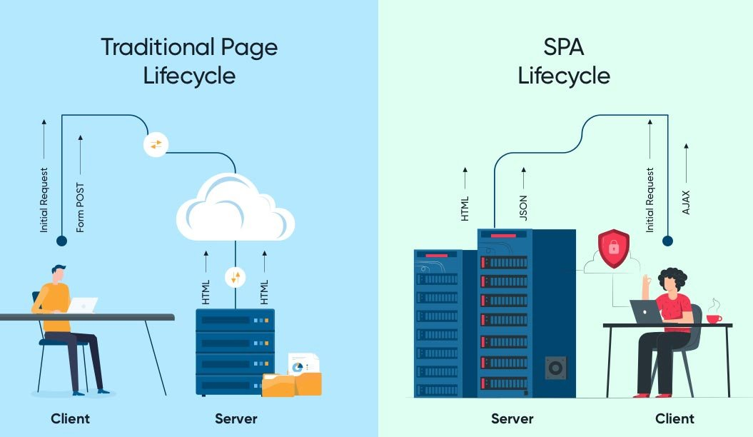

Slide 7
Single Page Application Pros - CSR
Quick Loading Time
Seamless User Experience
Ease in Building Feature-rich Apps
Uses Less Bandwidth

Slide 8
Desktop Application
(Cross Platform)
ELECTRON JS
BROWSER (Client Side)
REACTDOM
REACT COMPONENT
Mobile Application
REACT NATIVE
Node JS App (Server Side)
REACTDOMSERVER
Node JS App (Server Side)
REACTDOMSERVER

Slide 9
What is a JavaScript Library?
JavaScript libraries are collections of prewritten code snippets that can be used and reused to perform common JavaScript functions.
A particular JavaScript library code can be plugged into the rest of your project’s code on an as-needed basis.
This led to faster development and fewer vulnerabilities to have errors.

Slide 10
React JS
In 2011, Facebook created a JavaScript library called React, which specializes in helping developers build user interfaces or UI’s.
React JS is a web component-based library.
The web component-based library allows developers to avoid the pitfalls of rewriting code and dealing with complicated debugging.
With React, you can reuse and recycle different components across the web application or other products.

Slide 11
Component vs Traditional Approach
HTML and CSS
HTML and CSS
0
+
-
0
+
-
domHandler
domHandler
Counter
{
count: 0,
next: function() { this.count +=1; } ,
prev: function() { this.count -=1; }
}
Counter
{
count: 0,
next: function() { this.count +=10; } ,
prev: function() { this.count -=10; }
}
<Counter />
<Counter interval=“10”/>

Slide 12
UI Composition (Composite UI Pattern)
NAVIGATION
ADVER.
MENU ITEM
MENU ITEM
MENU ITEM
MENU ITEM
SIDE NAVIGATION
LIST AREA
DETAILS AREA
STATUS

Slide 13
REACT COMPONENT
View* (UI) – JS / JSX
Style (CSS) – JSX / CSS
Data (Inside) – State
Data (Outside) – Props
Behaviour - Methods

Slide 14
Installation
Install Node LTS version - https://nodejs.org/en/
Install / Update Visual Studio Code to Latest Release - https://code.visualstudio.com/
Extensions of VS Code
AutoFileName
vscode-icons
JavaScript (ES6) code snippets
CSS Formatter
IntelliSense for CSS class names in HTML
Reactjs code snippets

Slide 15
React Installation
Install Extensions on Google Chrome
React Developer Tools
https://chrome.google.com/webstore/detail/react-developer-tools/fmkadmapgofadopljbjfkapdkoienihi
Redux DevTools
https://chrome.google.com/webstore/detail/redux-devtools/lmhkpmbekcpmknklioeibfkpmmfibljd

Slide 16
React Client-Side Build
ES 2015 +
(Multiple Files)
react-scripts
Babel +
Preset (Env) +
Preset (React)
Polyfill (core-js)
Auto Configuration
react-cli (create-react-app)
Build & Deploy your
Project on Local Server
Build your project
Browser Compatible Files
(Multiple Files)
WEBPACK-DEV-
SERVER
WEBPACK
CLI
Bundling
BROWSER
WEBPACK
Single File / Set of Files
Local
HTTP Server
HTML PAGE
Deploy
Inject Bundles

Slide 17
Reference Links
Create React App - https://create-react-app.dev/
Advance Configuration - https://create-react-app.dev/docs/advanced-configuration

Slide 18
Using Bootstrap
Install
npm i bootstrap
npm i bootstrap-icons
Or
npm i bootstrap bootstrap-icons
Include bootstrap css, bootstrap module and bootstrap-icons css file in index.js

Slide 19
Assignment
Create and render the following components
Component One
Hello from Component One (text-success)
Component Two
Hello from Component Two (text-primary)

Slide 20
Styling React Component
Inline Style
Style in JS
Create your own local
Styled Components
External CSS
CSS Modules

Slide 21
State
The state is an updatable structure that is used to contain data or information about the component and can change over time.
The change in state can happen as a response to user action or system event.
It is the heart of the react component which determines the behavior of the component and how it will render.
It represents the component's local state or information.
It can only be accessed or modified inside the component or by the component directly.

Slide 22
Props
Props are read-only structure.
It is an object which stores the value of attributes of a component and work similar to the HTML attributes.
It allows passing data from one component to other components.
Props are immutable so we cannot modify the props from inside the component.

Slide 23
Props vs State
Props | State
Props are read-only. | State changes can be asynchronous.
Props are immutable. | State is mutable.
Props allow you to pass data from one component to other components as an argument. | State holds information about the components.
Props can be accessed by the child component. | State cannot be accessed by child components.
Props are used to communicate between components. | States can be used for rendering dynamic changes within the component.
Props make components reusable. | State cannot make components reusable.
Props are external and controlled by whatever renders the component. | The State is internal and controlled by the React Component itself.

Slide 24
How Browser Renders a Web Page?
DOM
HTML Parser
DOM Tree
Layout
HTML
Attachment
Render Tree
Painting
Display
CSS
CSS Parser
Style Rules (CSSOM)

Slide 25
Solution – Virtual DOM
Virtual DOM is an in-memory representation of real DOM.
It is a lightweight JavaScript object which is a copy of Real DOM.
Whenever setState() method is called, ReactJS creates the whole Virtual DOM from scratch.
At any given time, ReactJS maintains two virtual DOM, one with the updated state Virtual DOM and other with the previous state Virtual DOM.
ReactJS using diff algorithm compares both the Virtual DOM to find the minimum number of steps to update the Real DOM.

Slide 26
Virtual DOM
Updating virtual DOM in ReactJS is faster because ReactJS uses
Efficient diff algorithm
Batched update operations
Efficient update of subtree only
Uses observable instead of dirty checking to detect the change

Slide 27
props
Call setState()
React Component
(state)
Render function of the
Component is called by
Event Fired
ReactDOM
Ready for User Interaction
DELTA’s will be rendered and Browser DOM will update
New Virtual DOM
New Virtual DOM is compared with the Old Virtual DOM
DELTA’s

Slide 28
SyntheticEvent Object
Your event handlers will be passed instances of SyntheticEvent, a cross-browser wrapper around the browser’s native event.
It has the same interface as the browser’s native event, including stopPropagation() and preventDefault(), except the events work identically across all browsers.
The synthetic events are different from, and do not map directly to, the browser’s native events.

Slide 29
SyntheticEvent object attributes
boolean bubbles
boolean cancelable
DOMEventTarget currentTarget
boolean defaultPrevented
number eventPhase
boolean isTrusted
DOMEvent nativeEvent
void preventDefault()
boolean isDefaultPrevented()
void stopPropagation()
boolean isPropagationStopped()
void persist()
DOMEventTarget target
number timeStamp
string type

Slide 30
Controlled Component
A controlled component is bound to a value, and its changes will be handled in code by using event-based callbacks.
The input form element is handled by the react itself rather than the DOM.
The mutable state is kept in the state property and will be updated only with setState() method.
Controlled components have functions that govern the data passing into them on every onChange event occurs.
The data is then saved to state and updated with setState() method. It makes component have better control over the form elements and data.

Slide 31
Uncontrolled Component
It is similar to the traditional HTML form inputs. Here, the form data is handled by the DOM itself.
It maintains their own state and will be updated when the input value changes.
To write an uncontrolled component, there is no need to write an event handler for every state update.
You can use a ref to access the value of the form from the DOM.

Slide 32
Controlled vs Uncontrolled
Controlled | Uncontrolled
It does not maintain its internal state. | It maintains its internal states.
Here, data is controlled by the parent component. | Here, data is controlled by the DOM itself.
It accepts its current value as a prop. | It uses a ref for their current values.
It allows validation control. | It does not allow validation control.
It has better control over the form elements and data. | It has limited control over the form elements and data.

Slide 33
Rules to follow
In React data flows unidirectionally i.e. State to UI or from Parent to Child.
The state of the component, should be modified by the method of the same component.
If you are not using a data on the UI, do not put the data in the state of the component.

Slide 34
Parent Child Communication
PARENT
PARENT
Props
ref
Parent
Method
Reference
CHILD
CHILD

Slide 35
Sibling Communication
Parent Component
(State)
Parent
Method
Reference
Modify the state in
Parent component
props
CHILD Component
1
CHILD Component
2

Slide 36
Methods & Properties in a React Component Class
Instance Methods
constructor()
render()
setState()
componentDidMount()
componentDidUpdate()
shouldComponentUpdate()
getSnapshotBeforeUpdate()
forceUpdate()
componentDidCatch()
componentWillUnmount()
Instance Properties
state
props
context
Class Methods (static)
getDerivedStateFromProps()
getDerivedStateFromError()
Class Properties (static)
defaultProps
propTypes
displayName
contextType

Slide 37
Lifecycle Methods in a React Component Class
Mounting Phase
constructor()
static getDerivedStateFromProps()
render()
componentDidMount()
Updating Phase
static getDerivedStateFromProps()
shouldComponentUpdate()
render()
getSnapshotBeforeUpdate()
componentDidUpdate()
Unmounting Phase
componentWillUnmount()
Error Phase
static getDerivedStateFromError()
componentDidCatch()

Slide 38
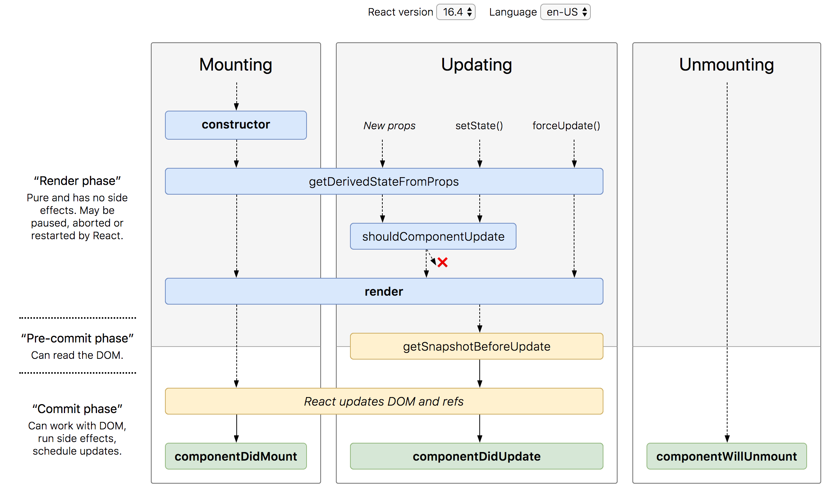
Lifecycle Methods

Slide 39
Error Boundaries
If the errors are not handled, the react component will crash and show a blank UI.
Error boundaries are React components that catch JavaScript errors anywhere in their child component tree, log those errors, and display a fallback UI instead of the component tree that crashed.
Error boundaries catch errors during rendering, in lifecycle methods, and in constructors of the whole tree below them.
Error boundaries do not catch errors for:
Event handlers
Asynchronous code (e.g. setTimeout or requestAnimationFrame callbacks)
Server side rendering
Errors thrown in the error boundary itself (rather than its children)

Slide 40
Create an Error Boundary
A class component becomes an error boundary if it defines either (or both) of the lifecycle methods static getDerivedStateFromError() or componentDidCatch()
Use static getDerivedStateFromError() to render a fallback UI after an error has been thrown.
Use componentDidCatch() to log error information.
The granularity of error boundaries is up to you.
You may wrap top-level components to display a “Something went wrong” message to the user, just like how server-side frameworks often handle crashes.
You may also wrap individual components in an error boundary to protect them from crashing the rest of the application.

Slide 41
Context
In a typical React application, data is passed top-down (parent to child) via props, but such usage can be cumbersome for certain types of props that are required by many components within an application.
Context provides a way to share values between components without having to explicitly pass a prop through every level of the tree.

Slide 42
Sibling Communication
CONTEXT
Parent Component
CHILD Component
1
CHILD Component
2

Slide 43
Assignment
Complete the CRUD assignment as per the screenshot shared in the next slide, use array to keep the data.
Create form-component and data-table-component as sibling components.
The data-table-component should be able to display array of any kind objects, do not fix the table to show only employees.

Slide 44
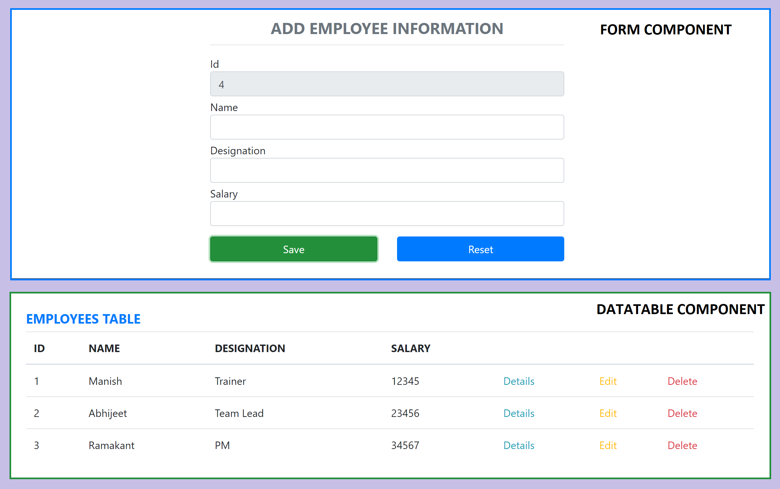
Assignment 3

Slide 45
AJAX and APIs
You can use any AJAX library you like with React.
Some popular libraries are:
Axios
jQuery AJAX
window.fetch
XMLHttpRequest
You should populate data with AJAX calls in the commit phase lifecycle methods like componentDidMount().
Use setState to update your component when the data is retrieved.

Slide 46
Hooks
Hooks are a new addition in React 16.8.
Hooks let you use state and other React features without writing a class.
Hooks are backwards-compatible
Built in Hooks
Basic Hooks
useState
useEffect
useContext
Additional Hooks
useReducer
useCallback
useMemo
useRef
useImperativeHandle
useLayoutEffect
useDebugValue

Slide 47
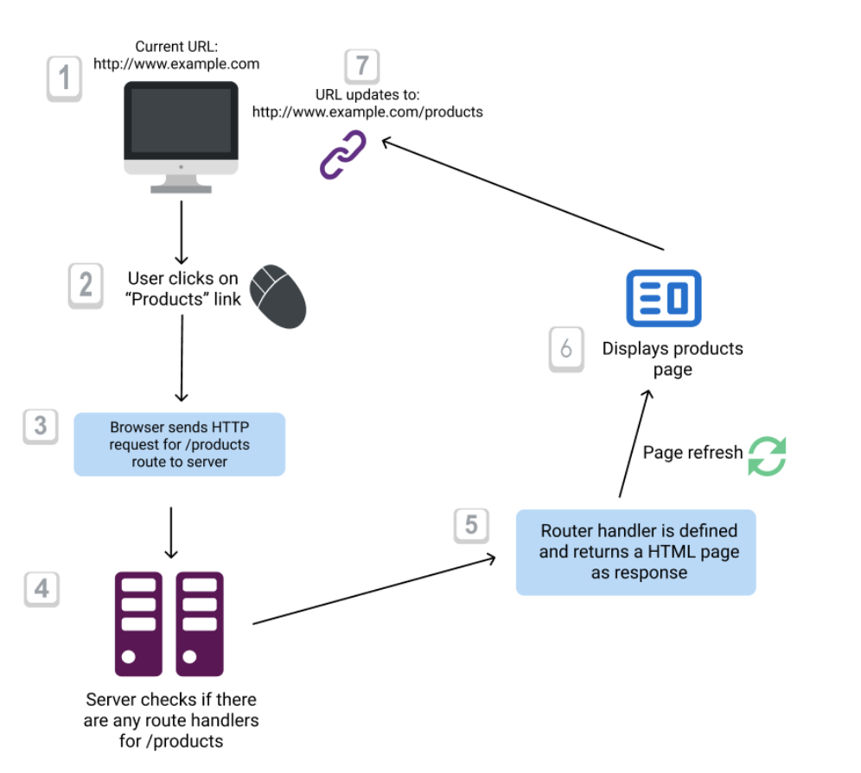
Conventional Routing

Slide 48
React Router
React Router is the de-facto React routing library, and it’s one of the most popular projects built on top of React.
React at its core is a very simple library, and it does not dictate anything about routing.
Routing in a Single Page Application is the way to introduce some features to navigating the app through links, which are expected in normal web applications:
The browser should change the URL when you navigate to a different screen
Deep linking should work: if you point the browser to a URL, the application should reconstruct the same view that was presented when the URL was generated.
The browser back (and forward) button should work like expected.
Routing links together your application navigation with the navigation features offered by the browser: the address bar and the navigation buttons.
React Router offers a way to write your code so that it will show certain components of your app only if the route matches what you define.

Slide 49
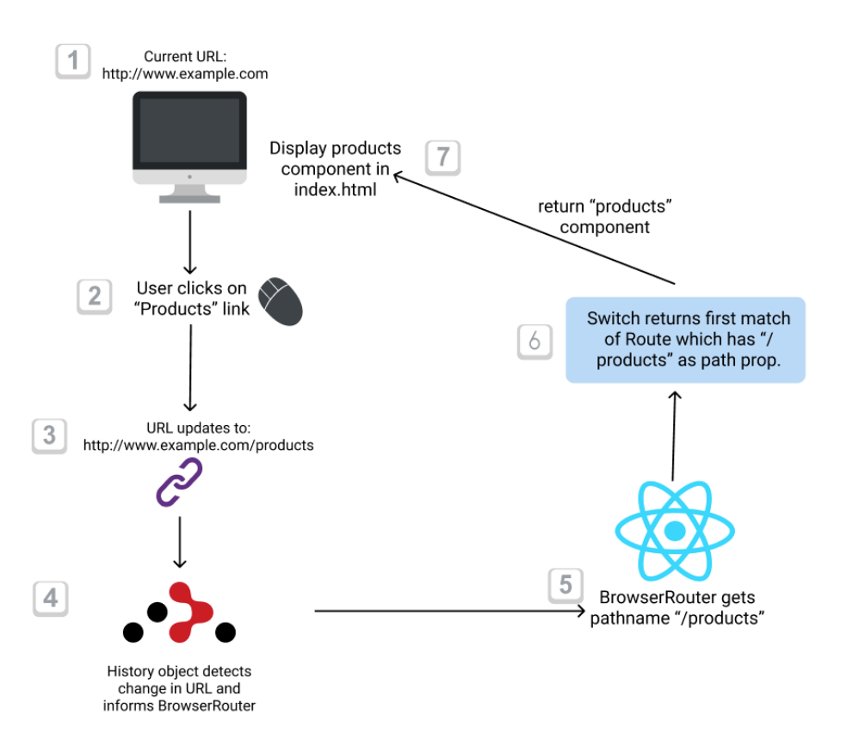
React Client-side Routing

Slide 50
Router Components
Install
npm i react-router-dom@5
The 3 components you will interact the most when working with React Router are:
BrowserRouter wraps all your Route components.
Link/NavLink components are used to generate links to your routes
Route components are responsible for showing - or hiding - the components they contain.

Slide 51
Assignment
Learn useContextHook
Change 5_communication-using-context code using Functional Component
Add Components for all other routes and load them lazily in react-routing-app
Check React Bootstrap Component Library

Slide 52
NODE SERVER
BROWSER
HTTP + URL (localhost:3000)
NAVIGATION
React Application
HTML Page + JS (React App)
NODE SERVER
EXPRESS JS
Web API
AJAX – localhost:8000/api/products
Database
JSON

Slide 53
How is it working?
User Clicks on Admin Link, React router maps the URL and displays the AdminComponent.
On componentDidMount, Call to the API is done to access Data from the API Server.
On success of the API call, the data is displayed in AdminComponent using DataTable Component.
On error, AdminComponent shows error messages.

Slide 54
NODE SERVER
BROWSER
HTTP + URL (localhost:3000)
NAVIGATION
React Application
HTML Page + JS (React App)
HTTP + URL (AJAX) + Username & Password
NODE SERVER
EXPRESS JS
Web API
JSON with Token
{“token”:”___”}
AJAX – localhost:8000/api/products + Token
Database
JSON

Slide 55
Secure Application using Custom Route
When user clicks the Admin Link, we need to verify that we have a token in session storage, and if the token in not there in the session storage, redirect the request to login component. (SecuredRoute)
SecuredRoute uses AuthenticatorClient’s isAuthenticated to verify.
If false, the request is redirected to Login Component.
If true, the request is allowed for Admin Component.
Logging and Token Management (AuthenticatorClient)
On Login Component, user must give username and password, which will be sent to Node API Server
If the username & password is correct, in the response; token will come from the Server
Received token will be stored in the session storage of the browser and isAuthenticated will be set to true.
Reading and Attaching Token
Whenever the AJAX request is made for api, we must read and attach the token in the request header.
We use AuthenticatorClient readToken() to read the token from session storage.

Slide 56
Fetch Interceptor
Interceptors are an excellent way to modify the HTTP request or response to make it more simple and understandable.
fetch-intercept monkey patches the global fetch method and allows you the usage in Browser, Node and Webworker environments.
https://www.npmjs.com/package/fetch-intercept
HTTP
Request
Interceptor
HTTP
Request
React Application
Server
HTTP
Response
HTTP
Response
We can manipulate or modify
the request or response

Slide 57
Secure Application using Custom Route
When user clicks the Admin Link, we need to verify that we have a token in session storage, and if the token in not there in the session storage, redirect the request to login component. (SecuredRoute)
SecuredRoute uses AuthenticatorClient’s isAuthenticated to verify.
If false, the request is redirected to Login Component.
If true, the request is allowed for Admin Component.
Logging and Token Management (AuthenticatorClient)
On Login Component, user must give username and password, which will be sent to Node API Server
If the username & password is correct, in the response; token will come from the Server
Received token will be stored in the session storage of the browser and isAuthenticated will be set to true.
Reading and Attaching Token (Fetch Interceptor)
Whenever the AJAX request is made for api, we must read and attach the token in the request header.
We use AuthenticatorClient readToken() to read the token from session storage.

Slide 58
HOC (Higher Order Components)
HOC is a pattern that emerges from React’s compositional nature.
A higher-order component (HOC) is an advanced technique in React for reusing component logic.
Component transforms props into UI, a higher-order component transforms a component into another component.
A higher-order component is a function that takes a component and returns a new component.

Slide 59
Why HOC?
Reason to use Higher-Order component:
Easy to handle
Get rid of copying the same logic in every component
Makes code more readable

Slide 60
Questions
When 2 or more components want to share data, where should we keep the data?
Parent Component
Context API (Provider & Consumer)
How will you maintain data related to multiple subcomponents in an application?
Multiple Contexts
How will you manage all the contexts in the application?

Slide 61
Redux
Redux is a pattern and library for managing and updating application state, using events called "actions".
It serves as a centralized store for state that needs to be used across your entire application, with rules ensuring that the state can only be updated in a predictable fashion.
The patterns and tools provided by Redux make it easier to understand when, where, why, and how the state in your application is being updated, and how your application logic will behave when those changes occur.

Slide 62
When Should I Use Redux?
Redux helps you deal with shared state management, but like any tool, it has tradeoffs. There are more concepts to learn, and more code to write. It also adds some indirection to your code and asks you to follow certain restrictions. It's a trade-off between short term and long-term productivity.
Redux is more useful when:
You have large amounts of application state that are needed in many places in the app
The app state is updated frequently over time
The logic to update that state may be complex
The app has a medium or large-sized codebase, and might be worked on by many people
Not all apps need Redux. Take some time to think about the kind of app you're building and decide what tools would be best to help solve the problems you're working on.

Slide 63
Redux Terminology
Actions - An action is a plain JavaScript object that has a type field. You can think of an action as an event that describes something that happened in the application.
Action Creators - An action creator is a function that creates and returns an action object. We typically use these, so we don't have to write the action object by hand every time
Reducers - A reducer is a function that receives the current state and an action object, decides how to update the state if necessary, and returns the new state. You can think of a reducer as an event listener which handles events based on the received action (event) type.
Store - The current Redux application state lives in an object called the store . The store is created by passing in a reducer.
Dispatch - The Redux store has a method called dispatch. The only way to update the state is to call store.dispatch() and pass in an action object. The store will run its reducer function and save the new state value inside. You can think of dispatching actions as "triggering an event" in the application.
Selectors - Selectors are functions that know how to extract specific pieces of information from a store state value.

Slide 64
Redux Application Data Flow

Slide 65
Thunk Middleware – Async Data Flow
Thunk is a logical concept in programming where you deal with a function that is primarily used to delay the calculation or evaluation of any operation.
Redux Thunk acts as a middleware that will return you a function instead of an object while calling through the action creators.
The returned function receives the dispatch method from the store and then later it is used to dispatch synchronously inside the body of function once the asynchronous actions have been completed.

Slide 66
Redux Application Async Data Flow

Slide 67
REACT COMPONENT → DISPATCHER (ACTION) → REDUCER → STORE →REACT COMPONENT
REACT COMPONENT → DISPATCHER (ACTION) → MIDDLEWARE → REDUCER → STORE →REACT COMPONENT

Slide 68
Points to Remember
ActionTypes are used for Creating Action Objects and also helps reducer to recognize Action which is dispatched to it.
REACT COMPONENT -> DISPATCHER -> ACTION -> REDUCER -> STORE -> REACT COMPONENT
How Component will know about the Dispatch/Dispatcher?
Component uses connect() to get access to the Dispatch which is used in mapDispatchToProps()
In functional components we use useDispatch() Hook
How Component will know about the State?
Component uses connect() to get access to state which is used in mapStateToProps(),
In functional components we use useSelector() Hook
How Component will know about the Actions?
Component takes the actions (action Objects) to be performed from ActionCreators (counterActions, productActions)

Slide 69
Contact Me
Manish Sharma | Gmail
Manish Sharma | WhatsApp
Manish Sharma | Facebook
Manish Sharma | LinkedIn

